Slide 1
Geography
Discuss the similarities and differences between Derbyshire, England and Texas, North America.

Slide 2
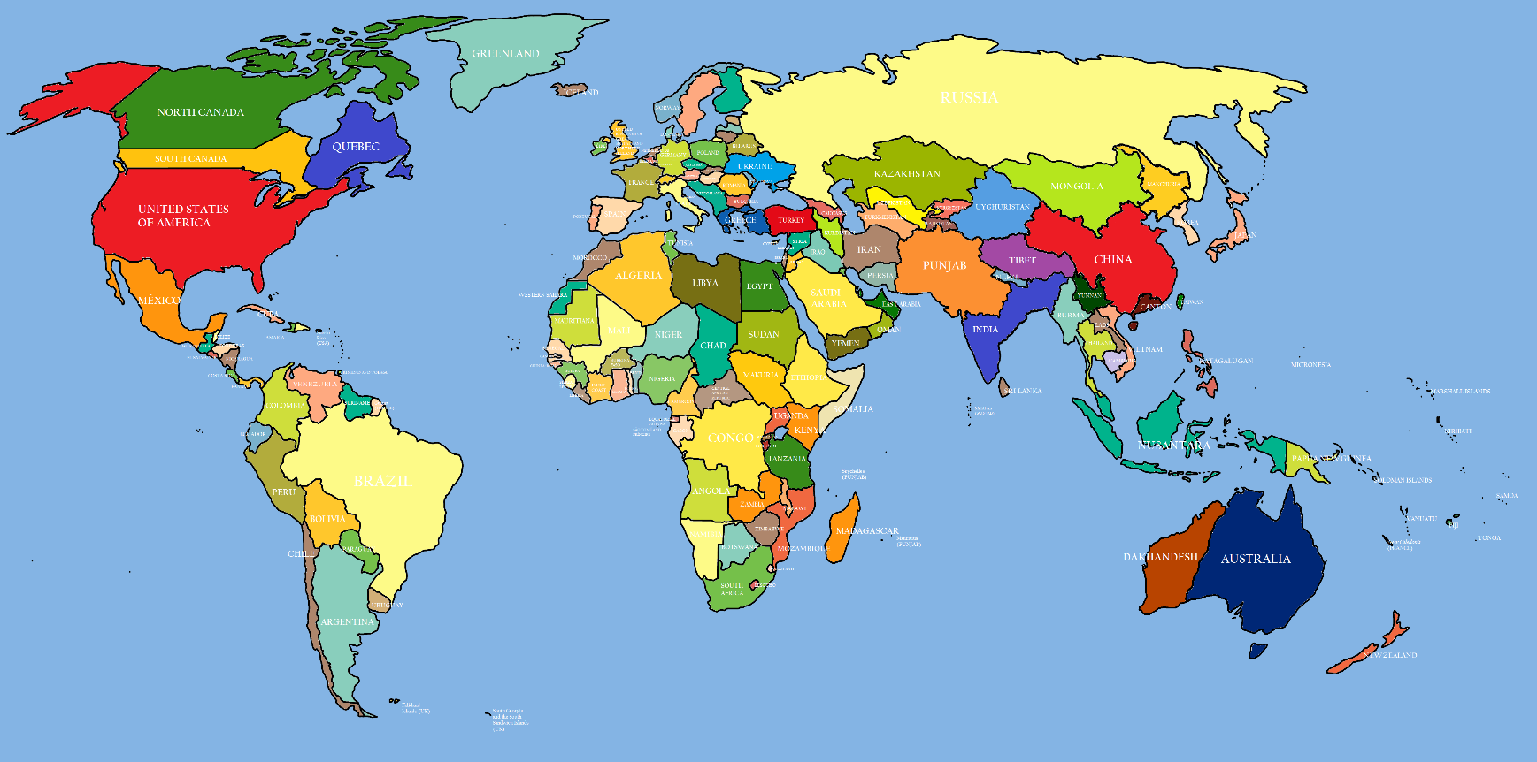
Challenge 1:
Find the United Kingdom on a map of the world.
Find the USA?

Slide 3
The USA:
The United States of America is a country on the continent of North America.
It is made up of 50 states.
Texas is just one of those 50 states.
Each state has it’s own government buildings, it’s own flag, it’s own culture.
U.S.A. Flag
Texas Flag

Slide 4
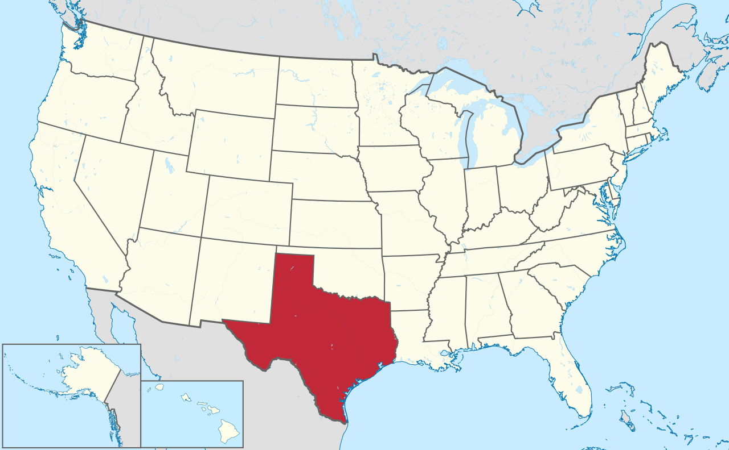
Texas is an easy state to spot: It has an unusual shape and it is the biggest state on the mainland USA

Slide 5
Texas:
Texas is famous for agriculture including cattle, sheep, goats, cotton, grains and fishing. It also produces oil, natural gas, petroleum products, cement, energy, and chemicals.
Texas is a Wild West holiday attraction and people visit Texas to learn how to horse ride and live like a real cowboy or cowgirl!
It has lots of famous bodies of water including the Gulf of Mexico, Rio Grande River, Pecos River, Red River, Colorado River, Brazos River and Toledo Bend Reservoir.
Animals that are distinctive to Texas are armadillos, Texas Longhorn (a type of cow) and Mexican free-tailed bats.
In Texas, the hottest month is July with temperatures reaching up to 50°C!
Central Texas is full of hills, mountains and rivers.

Slide 6
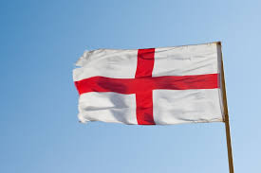
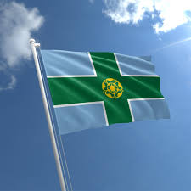
The UK:
The United Kingdom is on the continent of Europe.
It is made up of 4 countries (England, Scotland, Wales and Northern Ireland.)
Derbyshire is situated in England.
Like Texas, England has it’s own flag and so does Derbyshire!
England Flag
Derbyshire Flag

Slide 7
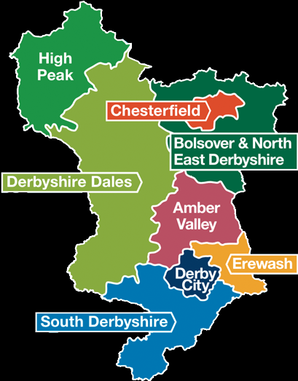
Derbyshire is near Chesterfield and is in the East Midlands of England.

Slide 8
Derbyshire:
Derbyshire is famous for the Peak District National Park, a popular tourist attraction.
Derbyshire has the city of Derby nearby and is close to Bakewell and Buxton.
Derbyshire has it’s own bodies of waters from the ‘cracking’ Castleton Water and Cromford Canal to the Erewash Canal and the Trent and Mersey Canal.
People visit Derbyshire for its cycling and walking trails.
Animals that are distinctive to Derbyshire are brown long-eared bats, stoats, wild cats, weasels, hedgehogs and deers.
In Derbyshire, the hottest month on average is July with temperatures reaching up to 30°C!
Derbyshire is full of green hills, lakes and rivers.

