Slide 2
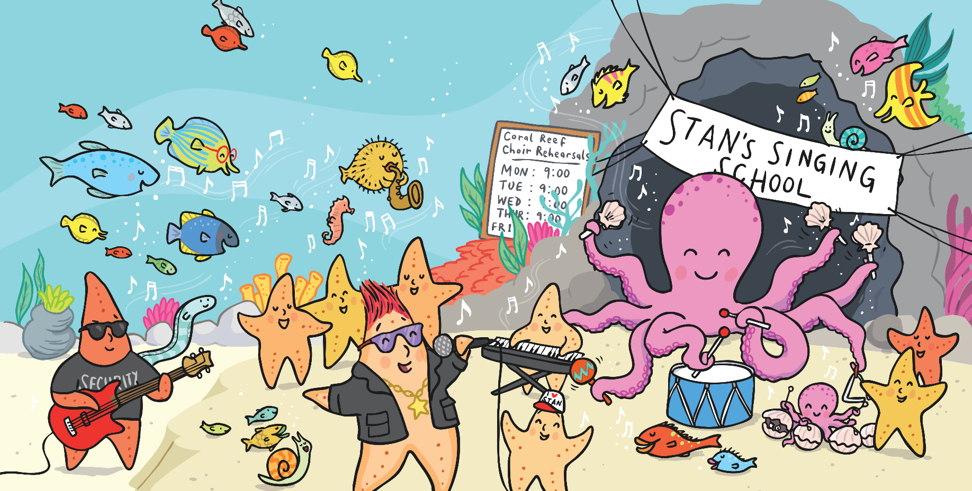
Musicians Wanted!
Starry-Eyed Stan needs some new musicians for his band.
Do you think you would be able to play some music?

Slide 3
Musicians Wanted!
To play in a band, it is very important that you can keep in time with your bandmates.
Can you follow a rhythm?

Slide 4
Follow the Rhythm
1 | 2 | 3 | 4
Clap | Clap | Clap | Clap
First, listen to the rhythm.
Now, join in. Clap and say the numbers in time.

Slide 5
Follow the Rhythm
1 | 2 | 3 | 4
Clap | Clap
 |  | Pat | Pat
Now, we’re going to split into two groups.
Half of you will clap but only on numbers 1 and 2.
The other half will pat your knees but only on numbers 3 and 4.
Can you keep in time?

Slide 6
Follow the Rhythm
1 | 2 | 3 | 4
Clap | Clap
 |  | Pat | Pat
This time, see if you can count quietly or in your head. Only say the number 1 out loud.

Slide 7
Follow the Rhythm
1 | 2 | 3 | 4
Clap | Clap
 |  | Pat | Pat
 |  |  | Pop
This time, some children will say the word ‘Pop’ but only on number 4.
Can you still keep in time?

Slide 8
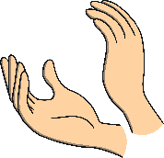
Follow the Rhythm
1 | 2 | 3 | 4
Clap | Clap
 |  | Pat | Pat
 |  |  | Pop
Beep
This time, some children will say the word ‘Beep’ but only on number 1.
Can you still keep in time?

Slide 9
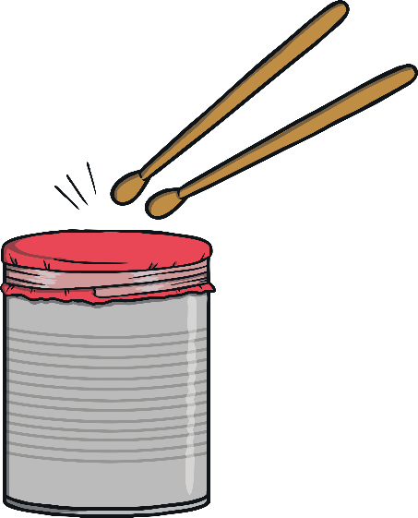
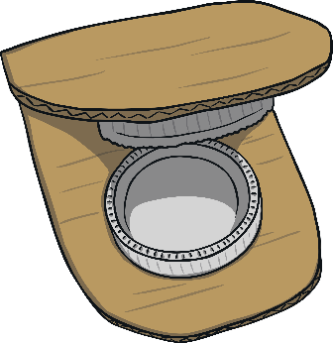
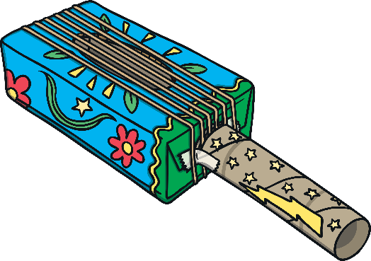
Let’s Make Music!
Now, let’s compose a piece of music with our instruments!
How many times should we play each instrument?
Can we still keep in time?
castanets
drum
maracas
guitar

Slide 10
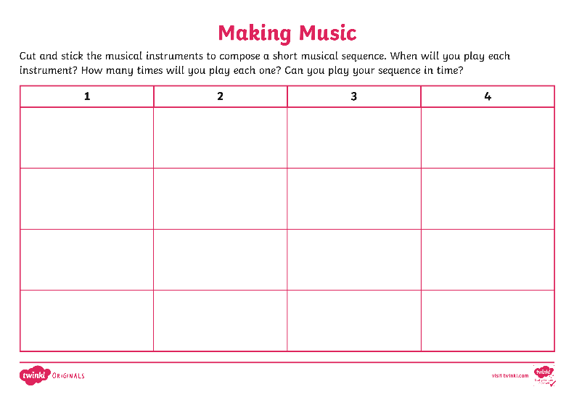
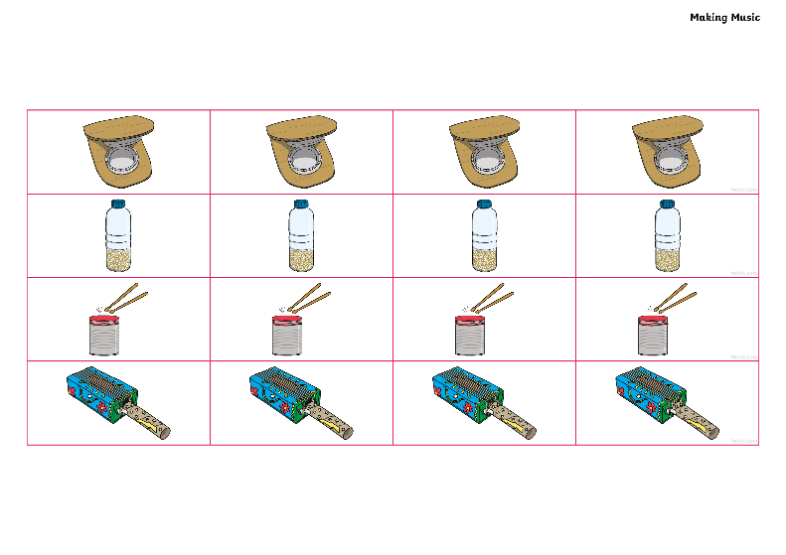
Let’s Make Music!
Now, it’s your turn!
Work with your group to compose your piece of music.
Then, practise playing your sequence.
Can you keep in time?

Slide 11
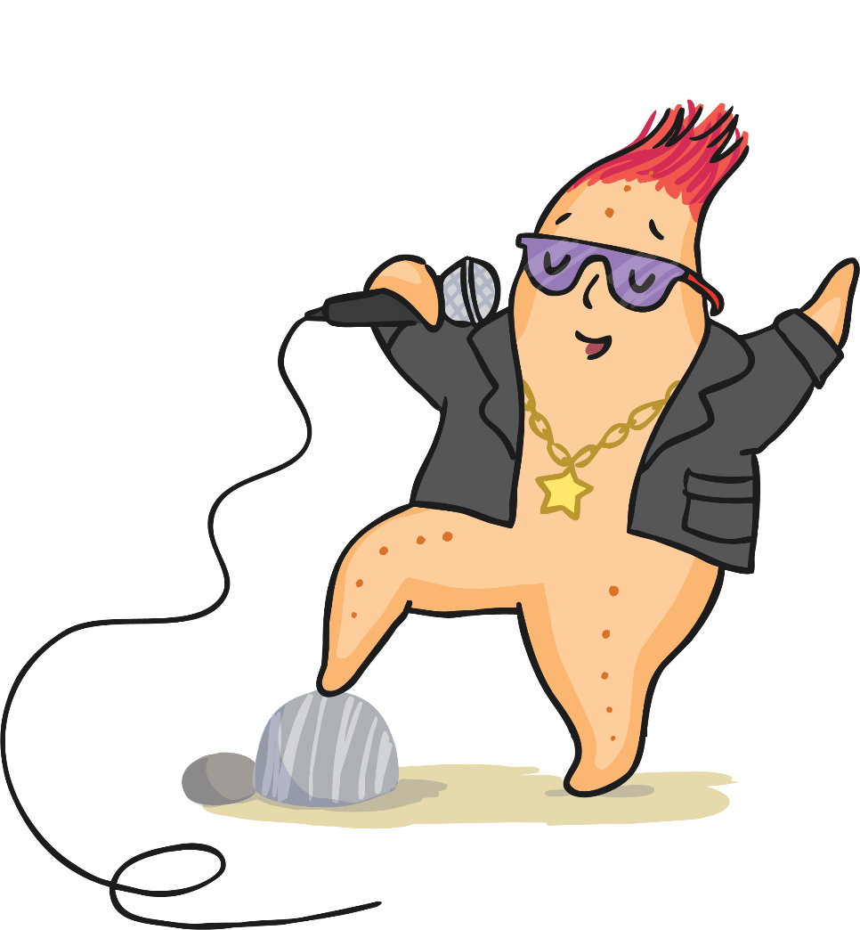
Perform Your Piece
Play your piece of music to another group.
Can they follow your sequence?
Listen to the piece of music by the other group.
What did you like about their piece of music?

Slide 12
Good Luck!
Starry-Eyed Stan will be in touch if you have got what it takes to join the band.
Good luck!

