Slide 1
Surviving the Wild West!
Basic needs of a cowboy!

Slide 2
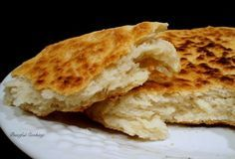
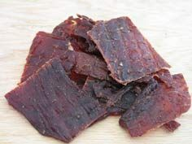
Food
Cowboys only had 2 meals a day (breakfast and supper) which was normally served in the back of a chuckwagon.
A cowboy’s diet consisted of beans (main source of protein), hard biscuits (made with only flour, water and salt), dried meat (similar to beef jerky) and dried fruit (mainly apples, apricots and raisins. Occasionally, they ate a bread called pan de campo (or “camp bread”.)
Although, cowboys herded cattle, they didn’t eat the beef from their own cattle because they needed to sell them to make money.

Slide 3
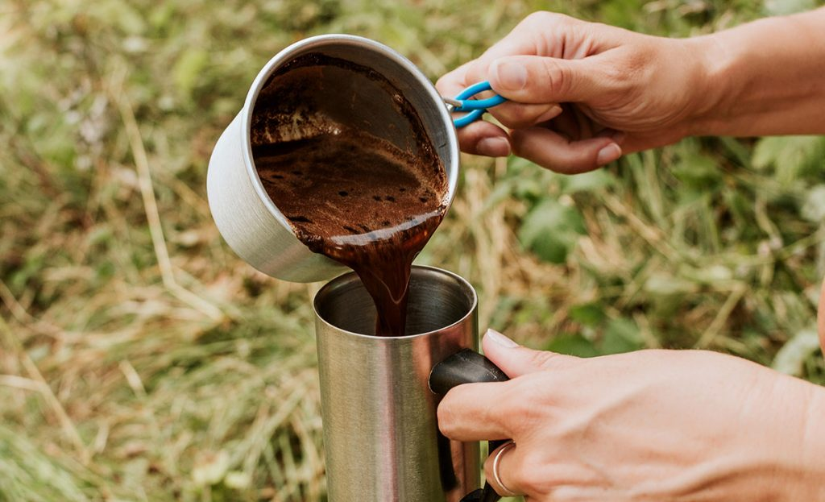
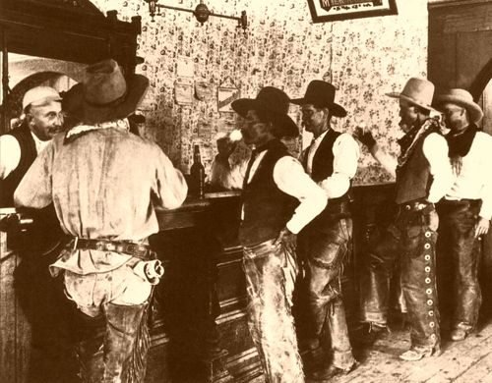
Drink
Cowboys were thought to have drank coffee made from boiled water and coffee beans.
Cowboys mainly drank whiskey (known to Indians as ‘firewater’) and occasionally beer if the saloon (their pub) had some in.
Cowboys didn’t drink water because they got their water from rivers, which were not very clean. They boiled the water to make coffee which made the water safe to drink!

Slide 4
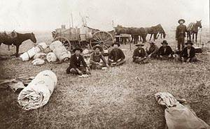
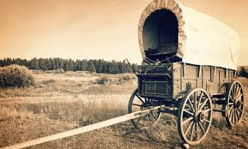
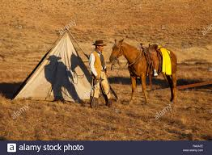
Shelter
Some cowboys moved from place to place so they would only have some rolled up wool blankets (called a bedroll) wrapped in a rubber canvas tarpaulin (which was waterproof.)
Some cowboys were lucky and they travelled with a chuckwagon which they could sleep in, as well as, cook in.
Some cowboys sheltered in canvas teepees (although these were mainly associated with Indians and their camps.)
If working on a ranch, a cowboy would be given a crude log cabin
to sleep in.

Slide 5
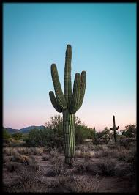
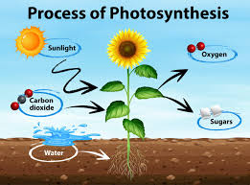
Oxygen
If order to live, all humans need oxygen. Plants provide us with oxygen by using the energy of sunlight, plants can convert carbon dioxide and water into carbohydrates and oxygen in a process called photosynthesis.
In the Wild West, cactus plants, snake plants and areca palm trees provided oxygen to the cowboys.

Slide 6
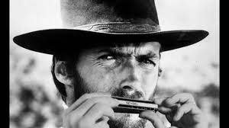
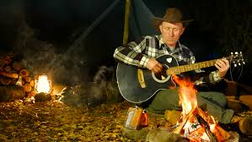
Family
All humans need to feel loved in order to survive. Cowboys didn’t live with their families because most moved from place to place.
Cowboys lived and worked with each other. They became each other’s family!
To past the time, cowboys sang songs, played the guitar or harmonica and wrote poetry.

