Slide 1
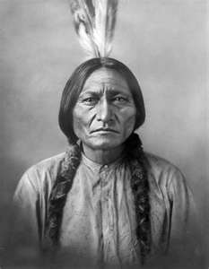
The Native Americans
Summer 2 – Week 6

Slide 2
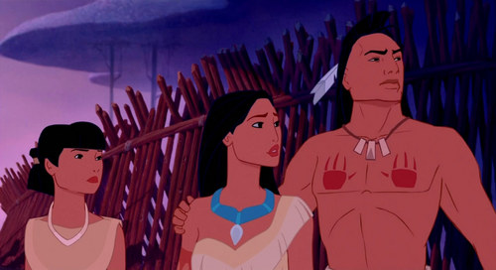
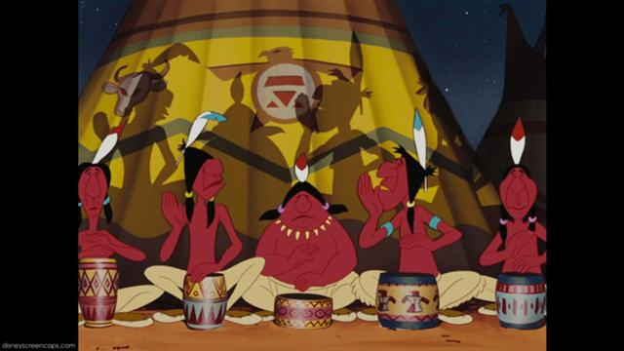
Who were the Native Americans?

Slide 3
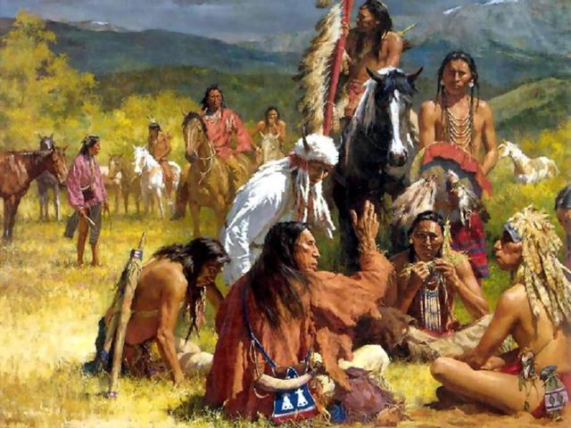
Who were the Native Americans?
People had been living in America for thousands of years before Christopher Columbus arrived in 1495.
He believed he had landed in India and noticed the natives wearing a lot of red paint. This is where the name ‘Red Indians’ came from.
There were ‘Plains Indians’ and ‘Forest Indians’ who lived differently, off the land around them.

Slide 4
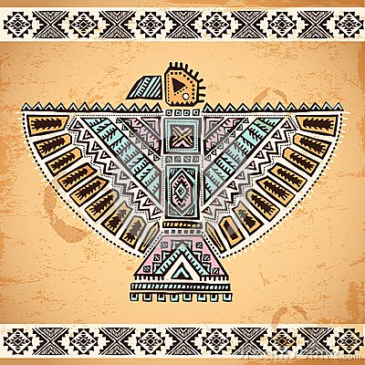
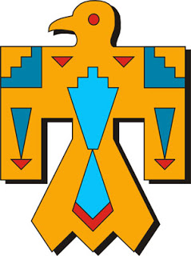
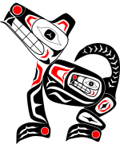
Tribes
Native Americans lived in tribes.
Each tribe had their own customs, language and history.
There were over 30 different Plains Indians tribes.
Tribes were split into bands, each containing a few hundred people.
Each tribe had a chief as a leader, and a council of elders who discussed issues and problems.
Most tribes had a medicine man, who was very wise and could contact the spirit world.

Slide 5
Native American Tribes

Slide 6
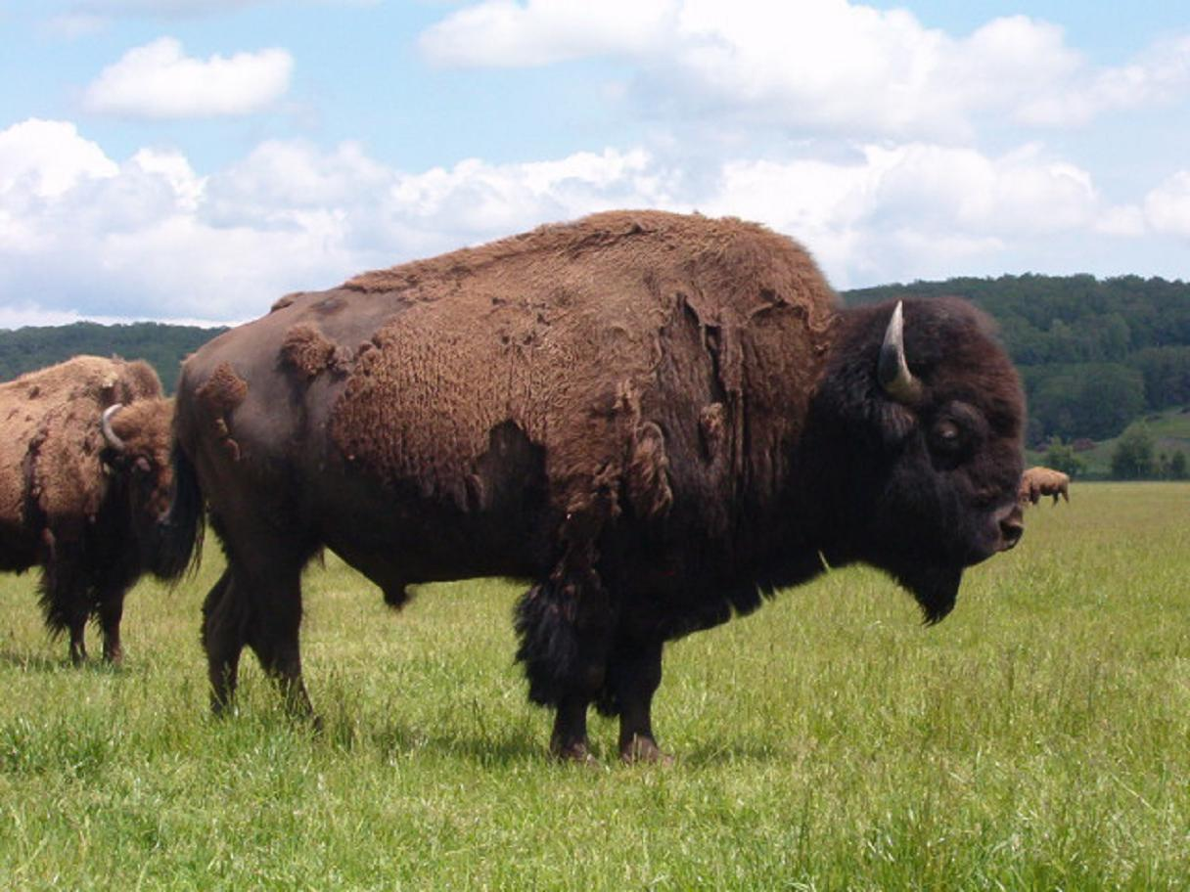
The Buffalo
Horns: cups, ladles, spoons, toys, powder cups, headdresses.
Hide (skin) clothes, paint pouches, moccasins, saddles, bags, tipi coverings, drums and shields.
Flesh: food – eaten raw, roasted or dried.
Brain: hide tanner
Tongue: hairbrush, food
Dung : Fuel
Tail – whips and decorations.
Fur: blankets, gloves, saddle covers, pillows, ropes.
Bladder: Pouches
Stomach: Containers, buckets and dishes.
Sinew: glue, bows, thread.
Bones: tools and knives
Hooves: Glue

Slide 7
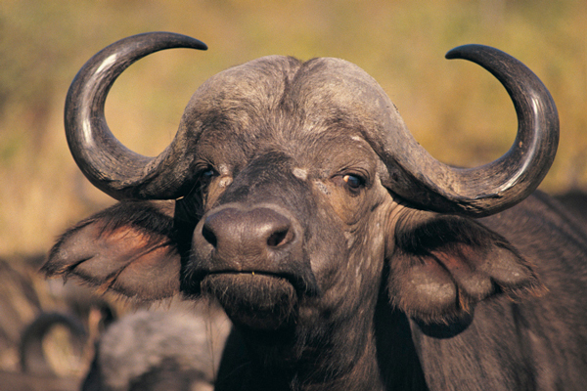
The importance of the Buffalo:
http://americanhistory.si.edu/buffalo/matching.html

Slide 8
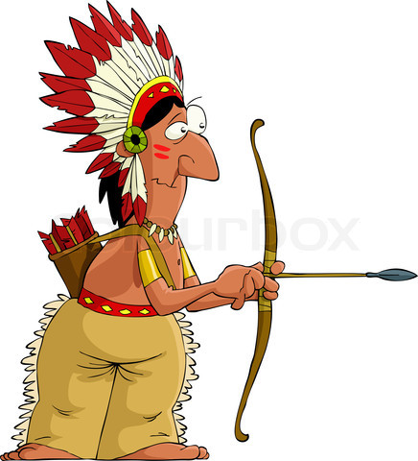
Nomadic Native Americans
As the Native Americans relied on the buffalos for survival, they had to be nomadic.
This means they followed the buffalo wherever they went.
What sort of houses would the Native Americans need to live in?

Slide 9
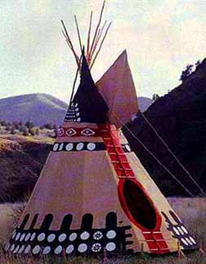
Teepees
The Native Americans lived in ‘Teepees’.
Open flaps allowed smoke for the fire to escape.
Teepee poles were used to form a sledge, which could be pulled by hand or horse. These were called a ‘Travois’.
Some were decorated, other tribes left their teepee plain.
Covers could be quickly taken down.

Slide 10
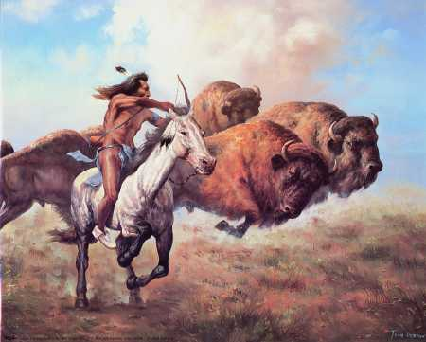
Daily Life
It was the job of the men to go hunting and fighting. It took a lot of skill to hunt a buffalo, and was very dangerous. They hunted on horseback, using a bow and arrow.

Slide 11
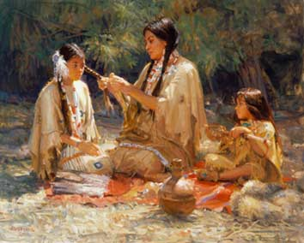
Daily Life
It was the job of the women to cook, clean, make and mend clothes and look after the children.

Slide 12
Native Americans and Nature
Native Americans had the greatest respect for the natural world and believed that no-one could own land – people or animals.
Earth respected them and gave them everything they needed to survive – in turn they respected the earth.
They believed there were spirits in every plant and animal.
http://www.youtube.com/watch?v=TkV-of_eN2w

